Slide 1

Affine Loop Optimization using Modulo Unrolling in CHAPEL
Aroon Sharma, Joshua Koehler, Rajeev Barua, Michael Ferguson

Slide 2
Outline
Introduction and Motivation
Previous Work
Modulo Unrolling
Optimized Cyclic and Block Cyclic Dists
Results
What about Block?

Slide 3
Our Work’s Contribution
We present an optimization for parallel loops with affine array accesses in CHAPEL.
The optimization uses a technique known as modulo unrolling to aggregate messages and improve the runtime performance of loops for distributed memory systems using message passing.

Slide 4
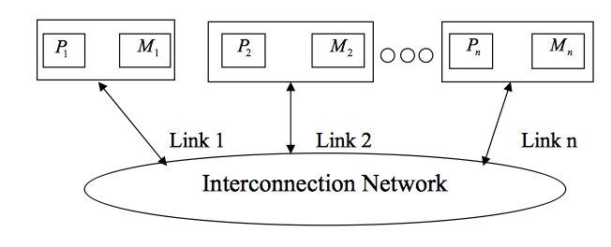
Message Passing Architectures
Communicate data among a set of processors with separate address spaces using messages
High Performance Computing Systems
100-1000+ compute nodes
Complicates compilation

Slide 5
PGAS Languages
Partitioned Global Address Space (PGAS)
Provides illusion of a shared memory system on top of a distributed memory system
Allows the programmer to reason about locality without dealing with low-level data movement
Communication and SPMD style like message passing systems for generated code

Slide 6

CHAPEL
PGAS language developed by Cray Inc.
Programmers express parallelism explicitly
Features to improve programmer productivity
Targets large scale and desktop systems
Opportunities for performance optimizations!

Slide 7
Affine Array Accesses
Most common type of array access in scientific codes
  A[i], A[j], A[3], A[i+1], A[i + j], A[2*i + 3*j]
  A[i, j], A[3*i, 5*j]
Array accesses are affine if the access on each dimension is a linear expression of the loop indices plus a constant term
  E.g. A[ai + bj + c] for a 2D loop nest
  Where a, b, and c are constant integer

Slide 8
Example Parallel Loop in CHAPEL
forall i in 1..10 do
A[i] = B[i+2];
What happens when the data is distributed?
1
2
3
4
5
6
7
8
9
10
11
12
13
14
15
A:
B:

Slide 9
Data Distributions in CHAPEL
Describe how data is allocated across locales for a given program
  A locale is a unit of a distributed computer (processor and memory)
Users can distribute data with CHAPEL’s standard modules or create their own distributions
Distributions considered in this study
  Cyclic
  Block
  Block Cyclic
Notes:
We don’t override the user’s chosen data distribution. This distribution could have been chosen for reasons unknown to the compiler. What we do want to do is improve the compilation for whatever distribution the user did choose.

Slide 10
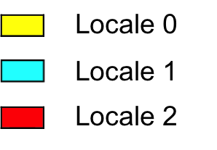
Data Distributions in CHAPEL - Block
use BlockDist;
var domain = {1..15};
var distribution = domain dmapped Block(boundingBox=domain);
var A: [distribution] int;
// A is now distributed in the following fashion
1
2
3
4
5
6
7
8
9
10
11
12
13
14
15
A:

Slide 11
Data Distributions in CHAPEL - Cyclic
use CyclicDist;
var domain = {1..15};
var distribution = domain dmapped Cyclic(startIdx=domain.low);
var A: [distribution] int;
// A is now distributed in the following fashion
1
2
3
4
5
6
7
8
9
10
11
12
13
14
15
A:

Slide 12
Data Distributions in CHAPEL – Block Cyclic
use BlockCycDist;
var domain = {1..15};
var distribution = dom dmapped BlockCyclic(blocksize=3);
var A: [distribution] int;
// A is now distributed in the following fashion
1
2
3
4
5
6
7
8
9
10
11
12
13
14
15
A:
*similar code is used to distributed multi-dimensional arrays

Slide 13
Distributed Parallel Loop in CHAPEL
forall i in 1..10 do
A[i] = B[i+2];
1
2
3
4
5
6
7
8
9
10
11
12
13
14
15
A:
B:
4 Messages
  Locale 1 → Locale 0 containing B[6]
  Locale 1 → Locale 0 containing B[7]
  Locale 2 → Locale 1 containing B[11]
  Locale 2 → Locale 1 containing B[12]

Slide 14
Message Passing is Inefficient in CHAPEL
Locality check at each loop iteration
  Is B[i+2] local or remote?
Each message contains only 1 element
We could have aggregated messages
  Using GASNET strided get/put in CHAPEL
  Locale 1 → Locale 0 containing B[6], B[7]
  Locale 2 → Locale 1 containing B[11], B[12]
Growing problem
  Runtime increases for larger problems and more complex data distributions

Slide 15
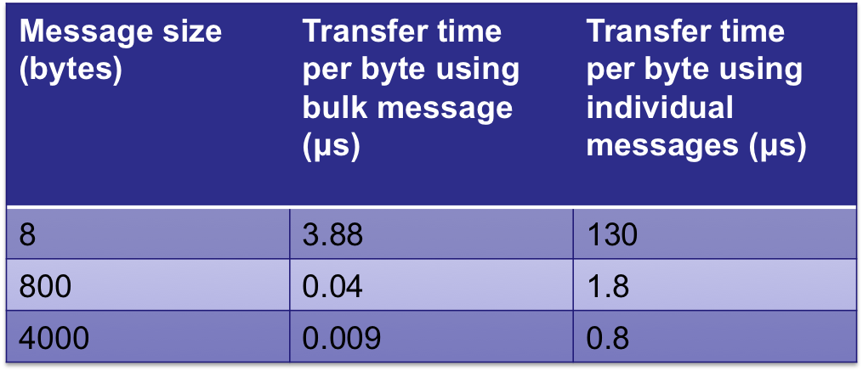
Message Passing is Inefficient in CHAPEL
Message size - # of 8-byte int to transfer | Bulk Transfer Time per 8-byte int Infiniband (μs) | Individual Message Transfer Time Infiniband (ms) | Bulk Transfer Time 10G Ethernet (μs) | Individual Message Transfer Time 10G Ethernet (ms)
1 | 31 | 1.04 | 145 | 5.075
100 | 33 | 1.475 | 172 | 12.980
500 | 37 | 3.25 | 181 | 19.382
*measurements taken on an LTS cluster

Slide 16
How to improve this?
Use knowledge about how data is distributed and loop access patterns to aggregate messages and reduce runtime of affine parallel loops
We are not trying to
  Apply automatic parallelization to CHAPEL
  Come up with a new data distribution
  Bias or override the programmer to a particular distribution
We are trying to
  Improve CHAPEL’s existing data distributions to perform better than their current implementation

Slide 17
Outline
Introduction and Motivation
Previous Work
Modulo Unrolling
Optimized Cyclic and Block Cyclic Dists
Results
What about Block?

Slide 18
Polyhedral Method
Boundaries traced for each array use of a loop and intersected with the data distribution
Applied to block distributions
Pros
  + aggregation at compile time for shared memory architectures
  + reduces dynamic runtime locality checks
Cons
  difficult to apply to more complex loops
  does not naturally translate to message passing architectures

Slide 19
Outline
Introduction and Motivation
Previous Work
Modulo Unrolling
Optimized Cyclic and Block Cyclic Dists
Results
What about Block?

Slide 20
Modulo Unrolling
Method to statically disambiguate array accesses at compile time
Unroll the loop by factor = number of locales
Each array access will reside on a single locale across loop iterations
Applicable for Cyclic and Block Cyclic

Slide 21
Modulo Unrolling Example
for i in 1..99 {
A[i] = A[i] + B[i+1];
}
Each iteration of the loop accesses data on a different locale
1
2
3
4
5
6
7
8
9
10
11
12
13
14
15
16
A:
…
B:
…
Locale 3

Slide 22
Modulo Unrolling Example
for i in 1..99 by 4 {
A[i] = A[i] + B[i+1];
A[i+1] = A[i+1] + B[i+2];
A[i+2] = A[i+2] + B[i+3];
A[i+3] = A[i+3] + B[i+4];
}
Loop unrolled by a factor of 4
1
2
3
4
5
6
7
8
9
10
11
12
13
14
15
16
A:
…
B:
…
Locale 3

Slide 23
Modulo Unrolling Example
for i in 1..99 by 4 {
A[i] = A[i] + B[i+1];
A[i+1] = A[i+1] + B[i+2];
A[i+2] = A[i+2] + B[i+3];
A[i+3] = A[i+3] + B[i+4];
}
Locale 0
Locale 1
Locale 2
Locale 3
A[1], A[5], A[9], …
A[2], A[6], A[10], …
A[3], A[7], A[11], …
A[4], A[8], A[12], …
B[1], B[5], B[9], …
B[2], B[6], B[10], …
B[3], B[7], B[11], …
B[4], B[8], B[12], …
1
2
3
4
5
6
7
8
9
10
11
12
13
14
15
16
A:
…
B:
…
Locale 3
How do we apply this concept in Chapel?

Slide 24
Outline
Introduction and Motivation
Previous Work
Modulo Unrolling
Optimized Cyclic and Block Cyclic Dists
Results
What about Block?

Slide 25
CHAPEL Zippered Iteration
Iterators
  Chapel construct similar to a function
  return or “yield” multiple values to the callsite
  Can be used in loops
iter fib(n: int) {
var current = 0,
next = 1;
for i in 1..n {
yield current;
current += next;
current <=> next;
}
}
for f in fib(5) {
writeln(f);
}
Being used in a loop
f is the next yielded value of fib after each iteration
Output: 0, 1, 1, 2, 3

Slide 26
CHAPEL Zippered Iteration
Zippered Iteration
  Multiple iterators of the same size are traversed simultaneously
  Corresponding iterations processed together
Output
Fibonacci 1 = 0
Fibonacci 2 = 1
Fibonacci 3 = 1
Fibonacci 4 = 2
Fibonacci 5 = 3
for (i, f) in zip(1..5, fib(5)) {
writeln(“Fibonacci ”, i, “ = ”, f);
}

Slide 27
CHAPEL Zippered Iteration
Can be used with parallel for loops
Leader iterator
  Creates tasks to implement parallelism and assigns iterations to tasks
Follower iterator
  Carries out work specified by leader (yielding elements) usually serially

Slide 28
CHAPEL Zippered Iteration
Follower iterators of A, B, and C will be
responsible for doing work for each task
forall (a, b, c) in zip(A, B, C) {
code…
}
Because it is first, A’s leader iterator
will divide up the work among available tasks

Slide 29
CHAPEL Zippered Iteration
It turns out any parallel forall loop with affine array accesses can be written using zippered iteration
forall i in 1..10 {
A[i] = B[i+2];
}
forall (a,b) in zip(A[1..10], B[3..12]){
a = b;
}
Zippered iteration
Implement modulo unrolling and message aggregation within the leader and follower iterators of the Block Cyclic and Cyclic distributions!

Slide 30
Modulo Unrolling in CHAPEL Cyclic Distribution
forall (a,b) in zip(A[1..10], B[3..12] do
a = b;
1
2
3
4
5
6
7
8
9
10
11
12
13
14
15
16
A:
…
B:
…
Locale 3
*if yielded elements are written to during the loop, a similar bulk put message is required to update remote portions of array
Leader iterator allocates locale 0 with iterations 1, 5, 9, …
Follower iterator of B recognizes that its work 3, 7, 11, … is remote on locale 2
Elements of B’s chunk of work brought to locale 0 via 1 bulk get message to a local buffer
Elements of local buffer are now yielded back to loop header
Locale 0

Slide 31
Modulo Unrolling in CHAPEL Block Cyclic Distribution
forall (a,b) in zip(A[1..10], B[3..12] do
a = b;
1
2
3
4
5
6
7
8
9
10
11
12
13
14
15
16
A:
…
B:
…
Locale 3
Aggregation now occurs with elements in the same location within each block
Both leader and follower needed to be modified
Locale 0

Slide 32
Outline
Introduction and Motivation
Previous Work
Modulo Unrolling
Optimized Cyclic and Block Cyclic Dists
Results
What about Block?

Slide 33
Benchmarks
Name | Description | Input (elements)
2mm | 2-d matrix multiplication | 128 x 128
cholesky | 2-d Cholesky decomposition | 128 x 128
jacobi | 2-d Jacobi relaxation | 400 x 400
stencil9 | 2-d 9-point stencil calculation | 400 x 400
folding | Sum consecutive elements of array using strided access pattern (1-d) | N = 50400, 10 iterations
pascal | Computes rows of pascal’s triangle | N1 = 999, N2 = 1002
* Data collected on 10 locale machine

Slide 34
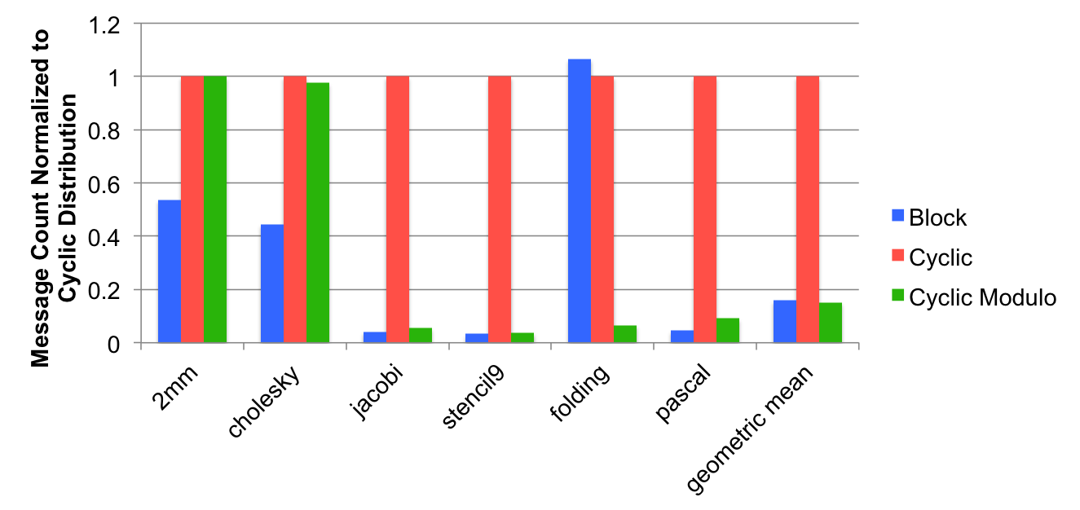
Comparing Cyclic Modulo Unrolling with Existing Distributions
*Data collection is still a work in progress

Slide 35
Outline
Introduction and Motivation
Previous Work
Modulo Unrolling
Optimized Cyclic and Block Cyclic Dists
Results
What about Block?

Slide 36
What about Block?
It seems that data distributed using Block naturally results in fewer messages for many benchmarks
Makes sense because many benchmarks in scientific computing access nearest neighbor elements
Nearest neighbor elements are more likely to reside on the same locale
Could we still do better and aggregate messages?

Slide 37
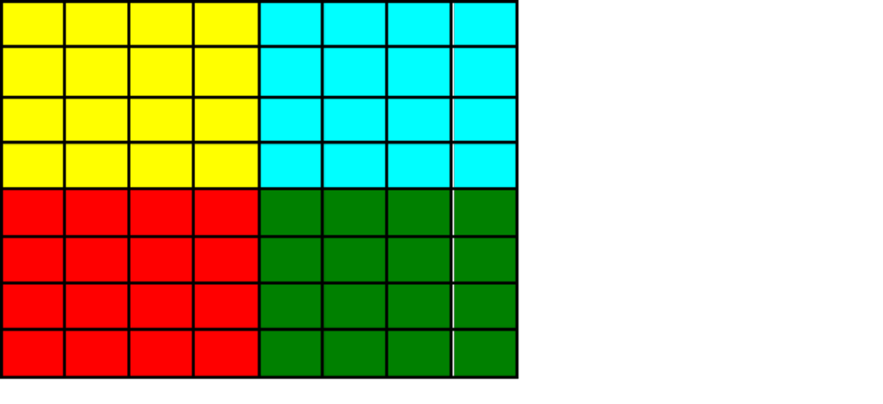
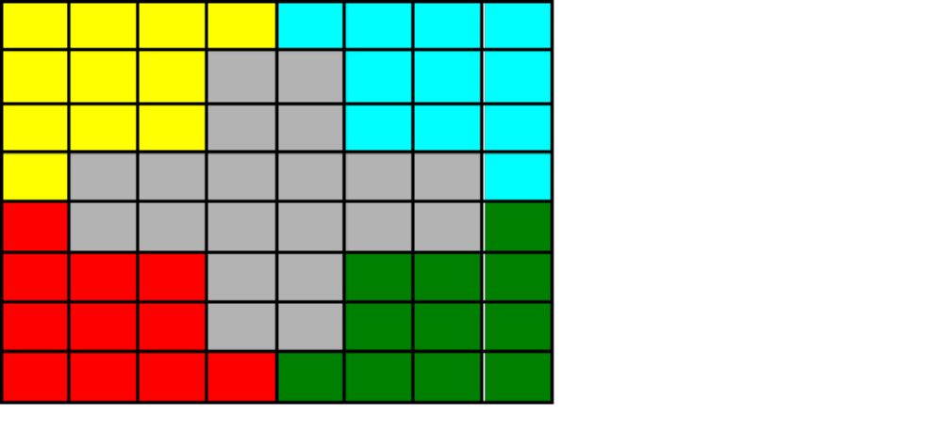
What about Block?
2D Jacobi Example
i
1
2
3
4
5
6
7
8
1
2
j
3
4
5
Locale 3
6
7
8
A[i, j-1]
A[i-1, j]
A[i, j]
A[i+1, j]
forall (i,j) in {2..7, 2..7} {
A_{new}[i,j] = (A[i+1, j] + A[i-1, j] + A[i, j+1] + A[i, j-1])/4.0;
}
A[i, j+1]

Slide 38
Conclusion
We’ve presented optimized Cyclic and Block Cyclic distributions in Chapel that perform modulo unrolling
Our results for Cyclic Modulo are comparable with CHAPEL’s existing Block distribution
Average message count reductions normalized to Cyclic
  Block: 0.158
  Cyclic Modulo: 0.151

Slide 39
References
[1] Barua, R., & Lee, W. (1999). Maps: A Compiler-Managed Memory System for Raw Machine. Proceedings of the 26th International Symposium on Computer Architecture, (pp. 4-15).
[2] User-Defined Parallel Zippered Iterators in Chapel, Chamberlain, Choi, Deitz, Navarro; October 2011

Slide 40
Questions?

